Slide 1

“Clinch’O Career” GROUP NO-75
Learning with AI
Under The Supervision of:- Mr. Vinay Agrwal
(Asst. Professor)
Department of CEA
GLA University, Mathura
Presented By:-
Vikash Jain (151400028)
Balveer (151400007)
Shivam Dhyani (151200353)
Govind Upadhyay (151500211)

Slide 2
Content
Introduction
Objective
Purpose
Hardware And Software Requirement
Tools and Technology
Data Flow Diagram
ER-Diagram
Snapshots
Conclusion
References

Slide 3
Introduction
Proposing a website that serves as common platform to students for various career activities.
Ease to students by providing menu wise different career activities options.
We are providing the virtual assistant to the every instructor which will answer the questions of the students which are enroll in that particular course.
The initial steps are sign up and login on the website.
The data which user provide will be kept secure.

Slide 4
Objective
To provide a common platform to students for different professional activities like higher studies, abroad studies & placements.
In this project we mainly provide the solution of doubt clearance of the students by the help of virtual assistant.
It will also serve the information about off-campus drive of companies in which a student is eligible to compete.
All the relevant material related to specific course, subject and topic will be available.
It will facilitate students to prepare for higher studies in their respective fields.
Students can examine the expenditure for abroad studies and information of colleges will be provided according to their academic results.

Slide 5
Purpose
Users ease ,anytime anywhere website accessibility.
Providing information updates.
Saving accessing and surfing time.
To present the authentic and true information to user.

Slide 6
Hardware And Software Requirement
Hardware Requirement:-
Processor Intel Dual Core(1 GHz) or above
RAM 512 MB or above
Hard-disk min 4 GB
Software Requirement:-
Operating System Windows
Language HTML,CSS, JavaScript, PHP
Browser Any Browser(JavaScript supported)

Slide 7
Tools And Technology
WAMP: Wamp is a free and open source Windows platform (W), Apache (A), My SQL (M), PHP (P) . It is a simple, lightweight Apache distribution that makes it create a local web server for testing and deployment purposes.
Technology:-
HTML: – It is used for giving eye catching look to the website. And also providing easy to use GUI.
CSS: – CSS is cascading style sheet which is used to give designer look to HTML using the external file.
Java script: – Java script is used for client side scripting which can help in using validation on the website and many more other functions.
PHP: - PHP (hypertext preprocessor) is a widely-used open source general-purpose scripting language that is especially suited for web development and can be embedded into Html.

Slide 8
Data Flow Diagram
LEVEL-0
Request for Course
Clinch’O Career
Provides
Student
Teacher
Enrolled
Teaches
Manage
Admin

Slide 9
Payment process
LEVEL-1
Finance
course
Search
course
Payment
process
Pay for Course
Payment
process
Registration
info
Register for course
Pay Salary
View Study details
Student
study material
Manage Student/ Instructor
Admin
Login/signup
Instructor
Student
Upload Study
Performance
Login
OLT
Login info
Login info
Login info
Admin
Instructor
Student

Slide 10
ER-DIAGRAM
Std_name
Last name
Mobile
No.
First name
Email Id
Stud_id
Xth marks
Mobile no.
Faculty_id
Instructor
Student
Email Id
XIIth marks
Salary expected
upload
Study material
N
Course Expertise
Grad Marks
N
N
Manage
N
Apply for
Pay Salary
N
N
1
1
Information Upload
N
Manage
1
Courses
ADMIN
Course_Id
OLT
Admin_ID
Faculty /Student Payment
Course_name
No. of lectures
Comp Mang.
Course Fee
Decides Course fee

Slide 11


Slide 12
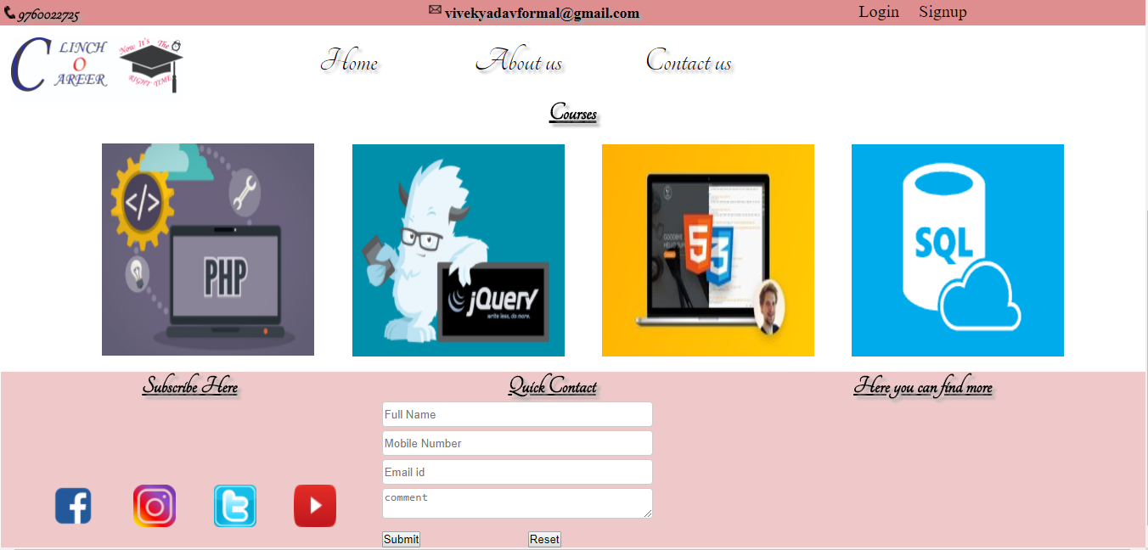

Slide 13


Slide 14
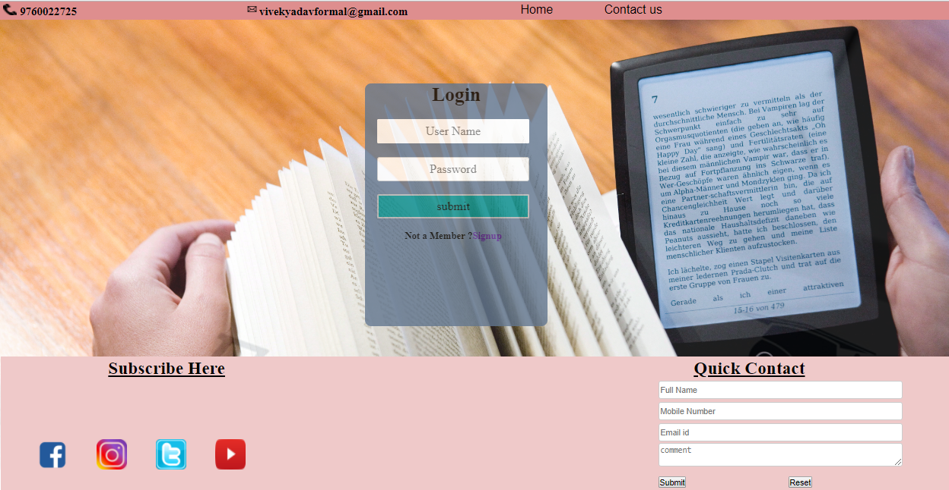

Slide 15
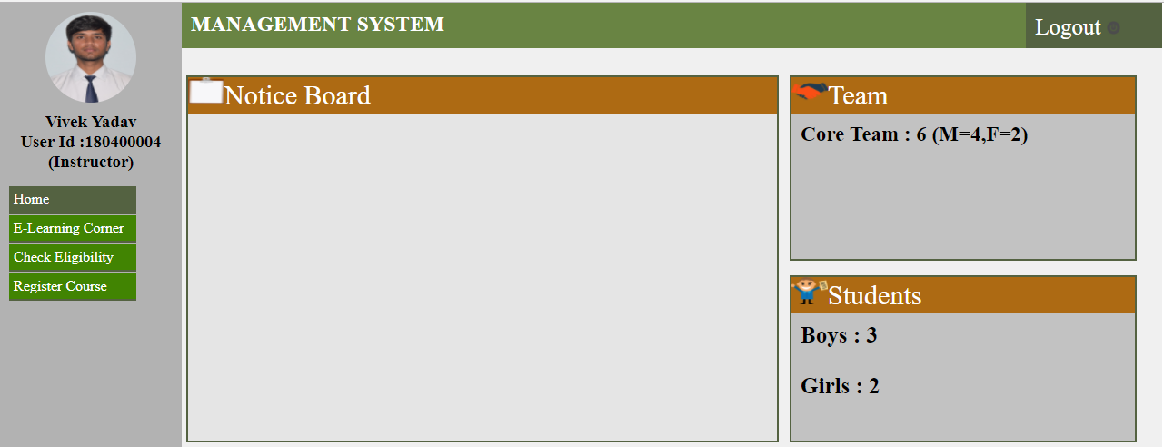

Slide 16
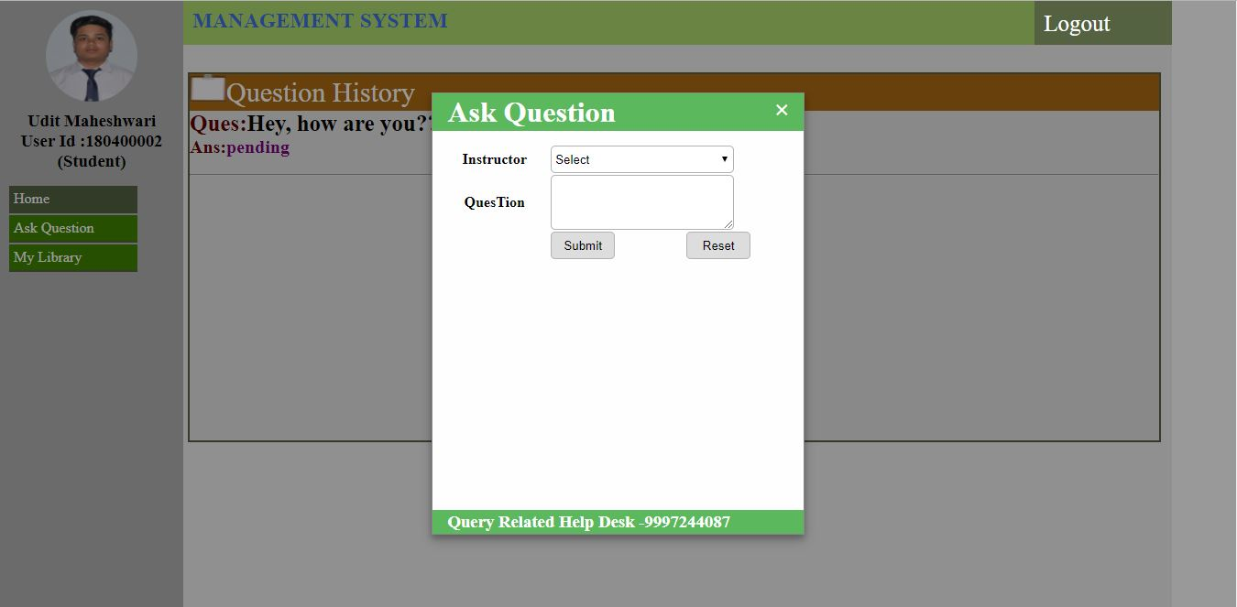

Slide 17


Slide 18
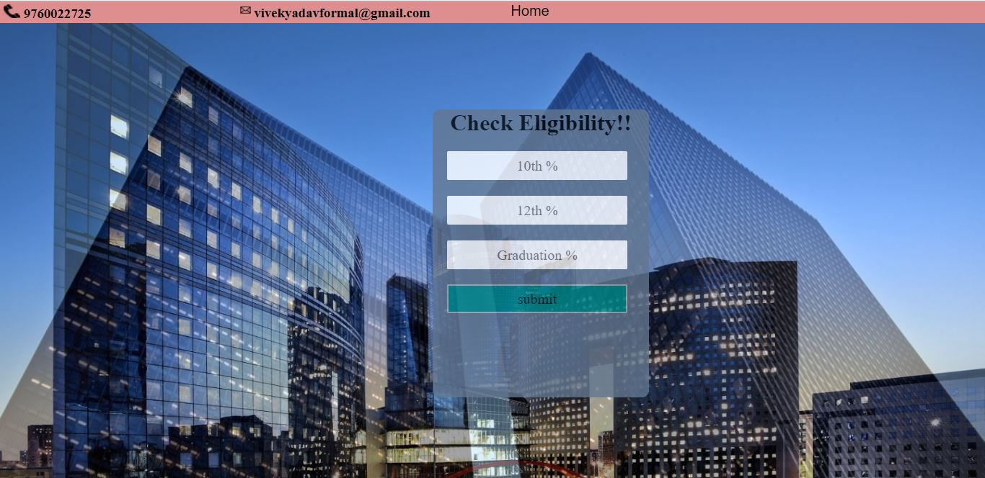

Slide 19
CONCLUSION
Easiest way to find Eligibility in MNC’s.
Get Updates about College Entrance criteria.
Reduces time & effort.

Slide 20
REFERENCES
www.youtube.com
www.w3schools.com
www.tutorialspoint.com

Slide 21
THANK YOU

